Slide 1
Studio Web workshop Day 3 – API Integration and Leveraging Chat GPT for Resume screening
Speakers: Lakshman Ganta & Mudhukrishna Lalapet

Slide 2

About Me:
I have 6+ Years of experience into RPA UiPath and around 8 Years of experience in IT Industry
Started My journey as a Java Developer and then moved into RPA
Now associated with Broadridge Financial Solutions as a RPA Technology Lead
I received UiPath MVP award for 2022 & 2023 and also got 14 community awards
from UiPath.

Slide 3

Myself :
Experienced professional in the field of RPA with over 5 years, worked on a wide range of projects across different industries, including finance, healthcare, manufacturing, logistics and currently automotive.
Associated with Forvia as a Technology Lead (AI/ML).
Worked as Software Intern in Indian Space Research Organization(ISRO)
UiPath MVP for 2022 and certified UiPath Community
Trainer.

Slide 4
Agenda
1. Usecase Description : API Integration
2. Overview of API Calls
3. 4. Studio Web walk-through & Demo
4. Usecase Description : ChatGPT
5. Applications used in the Usecase
6. Studio Web walk-through & Demo
7. Q & A

Slide 5
Usecase Description
The use case involves using UiPath Studio Web to automate the process of finding colleges based on specific criteria using a college search API. The goal is to retrieve a list of colleges that match the given parameters, such as location, degree programs, tuition fees, and more.

Slide 6
Overview of API Calls
An Application Programming Interface (API) is a set of rules and protocols that allows different software applications to communicate and interact with each other. It defines the methods and data formats that applications can use to request and exchange information, services, or functionality.
Importance :
Structured Communication: API calls provide a structured and standardized way for systems to communicate and exchange data.
Efficiency: APIs enable efficient data exchange between systems. Instead of transferring entire datasets or files, API calls allow systems to request and exchange only the specific data they need.

Slide 7
Usecase Walk-through & Demo

Slide 8
Usecase Description
Recruitments, performance management, employee engagement, and internal activities are just a few of the many responsibilities managed by the human resource (HR) departments. AI has the ability to greatly enhance HR operations, making them more productive and successful.
The recruitment process can be time-consuming and resource-intensive, involving tasks such as sourcing candidates, screening resumes, conducting initial interviews, and more. In this use case, we can use the AI and RPA capabilities of UiPath to automate the resume screening process to provide useful insights on the applicants to speed up the process of selection.

Slide 9
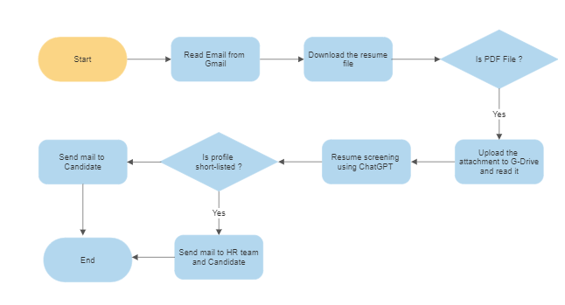
TO-BE WORKFLOW

Slide 10
Used Applications
1. UiPath Studio Web
2. Integrating UiPath Studio Web with
a. Gmail
b. Google Drive
c. OpenAI
3. PDF

Slide 11
Usecase Walk-through & Demo

Slide 12




Vibrant ecosystem of more than 2 million professionals and citizen developers learning,
getting support, and succeeding together in their automation careers.
Academy
Learn the skills of the future on UiPath Academy or through our Academic Alliance
Earn globally recognized credentials with UiPath Certifications
Forum
Get crowdsourced support and share product feedback on UiPath Forum
Check the product documentation
Community Events
Connect with like-minded people and share best practices with the UiPath Community
Solve challenges in engaging hackathon competitions
Join meetups and conferences
Join the UiPath Community

Slide 13
Questions?
Ask your Questions in chat or speak up!

